Slide 1
Physics 201
Winter 2013
Energy

Slide 2
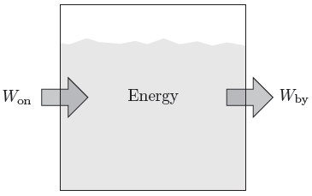

The energy level of a system represents ability to do work
Winter 2013
Energy is a property of the system – something it “has”
When a system does work on another, a transfer of energy occurs: the energy level of one decreases while the other increases
Energy is like mechanical currency: the system spends and earns it through work
Show me

Slide 3
Work can create energy in three different ways
Winter 2013
Kinetic
Energy
Creates motion
(linear or rotation)
Work
Potential
Energy
Displacement
from equilibrium
Heat
Energy
Temperature or phase change

Slide 4
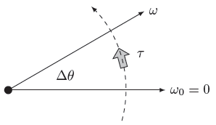



Work done on a single rigid object creates kinetic energy
Winter 2013

Slide 5
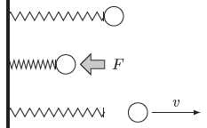
When driving from equilibrium, work creates potential energy
Winter 2013
Potential energy is work against the internal forces of the system
Potential energy ultimately depends on the internal configuration of the system
Different forces will involve different values of potential energy…
Force | Potential Energy
Weight
Gravity
Spring

Slide 6
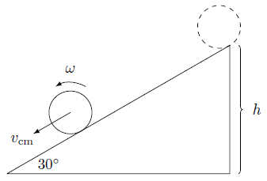
Conservation of energy
Winter 2013
The key to use energy is to find a moment in time in which you know all of the elements of the energy in order to calculate the total energy of the system
If there are no external forces, the total energy is always the same
Show me

Slide 7
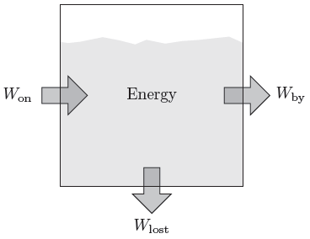
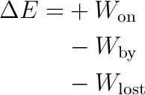
Resistive forces destroy mechanical energy
Winter 2013
Work done on an internal conservative force is released when the system returns to the original configuration
This is why potential energy depends on the configuration of the system rather than the means whereby it is rearranged
But friction opposes motion – it always does negative work
Show me

Slide 8
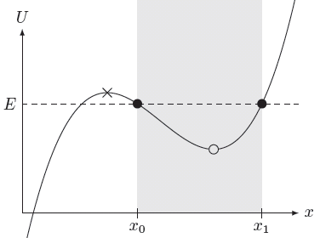
Energy diagrams
Winter 2013
Changes in energy level are either from
  External forces or
  Non-conservative
  internal forces
Conservative internal forces transform energy
Friction will drive a system to equilibrium = stability
Stable equilibrium

